Slide 1
Presentation on The wonders Of Nature Name:Yasin Borkondaz Roll:01-041-17 Batch:41 Dept:Geology and Mining Date:08-12-2024

Slide 2
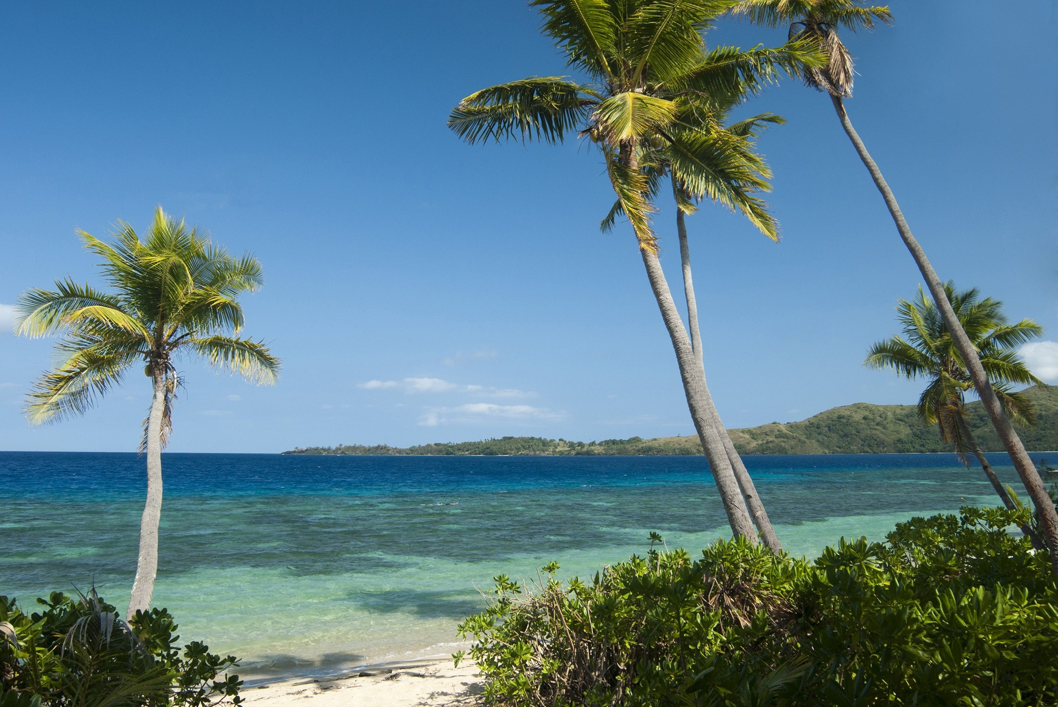
Parts of nature
1.Ocean 2.Himalaya 3.Hill 4.Trees 5.Different Animals
This Photo by Unknown Author is licensed under CC BY

Slide 3
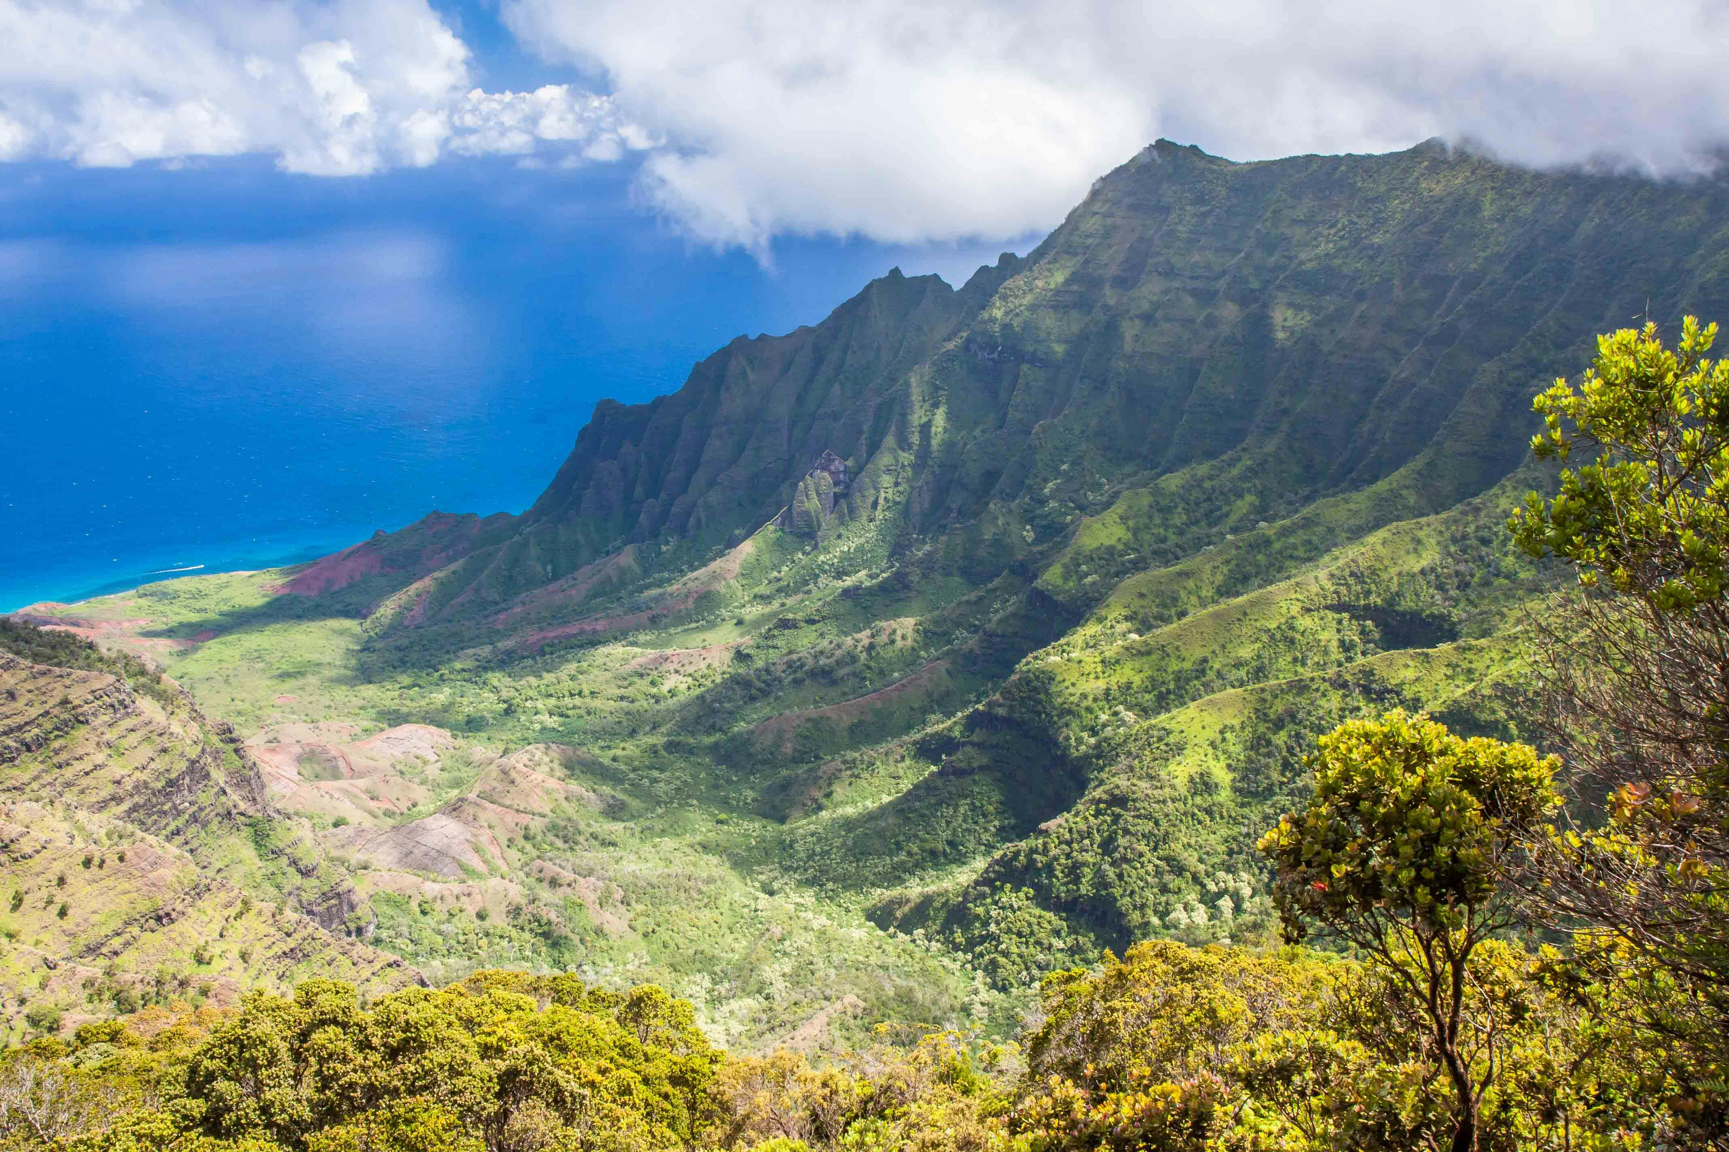
Anothers part of Nature
Soil
water
Birds
River
water

Slide 4
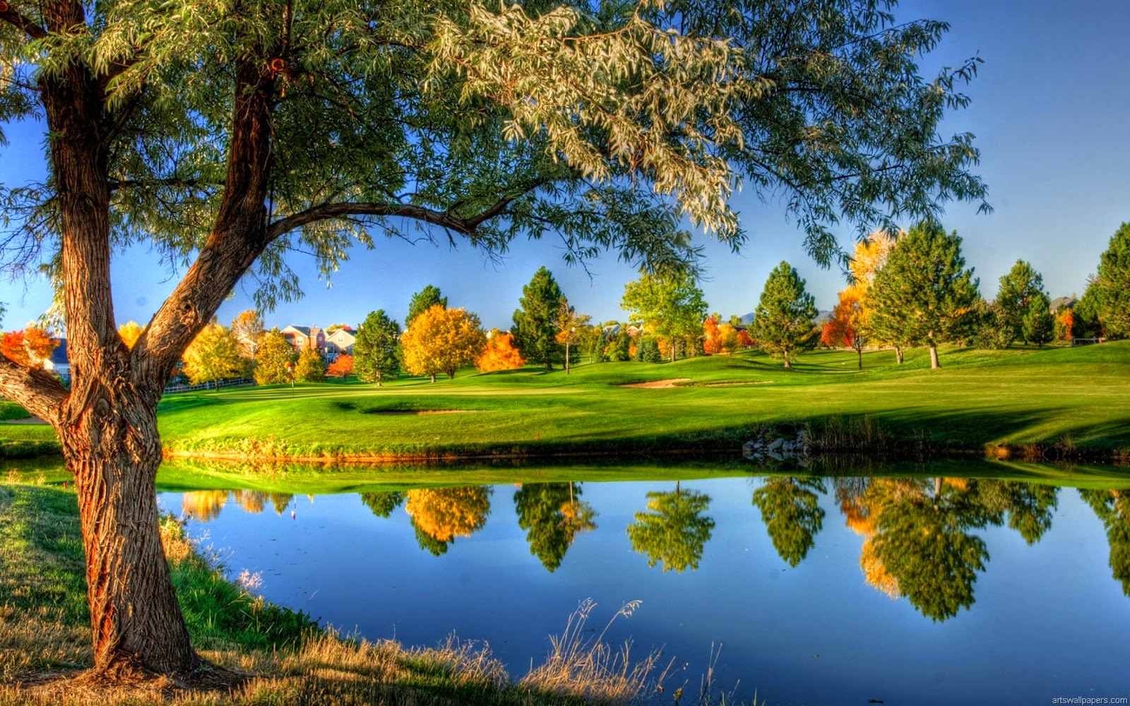
Benefits of nature
Gives happyness
Gives freshness
Gives the life hold thinks
This Photo by Unknown Author is licensed under CC BY-NC-ND

Slide 5
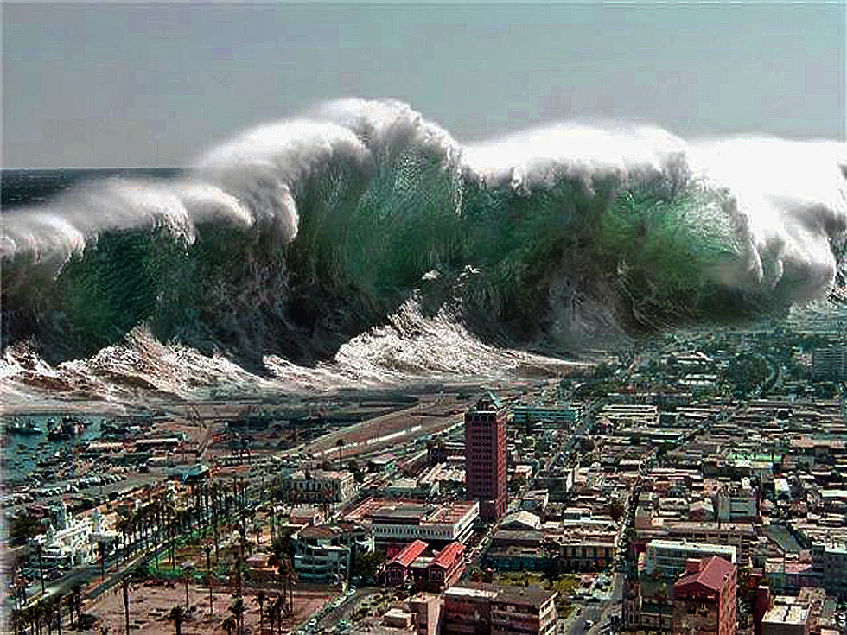
Effect of Nature
Humper life
Loss of econome
Creat natural desester
Loss of crops
This Photo by Unknown Author is licensed under CC BY-SA-NC

Slide 6
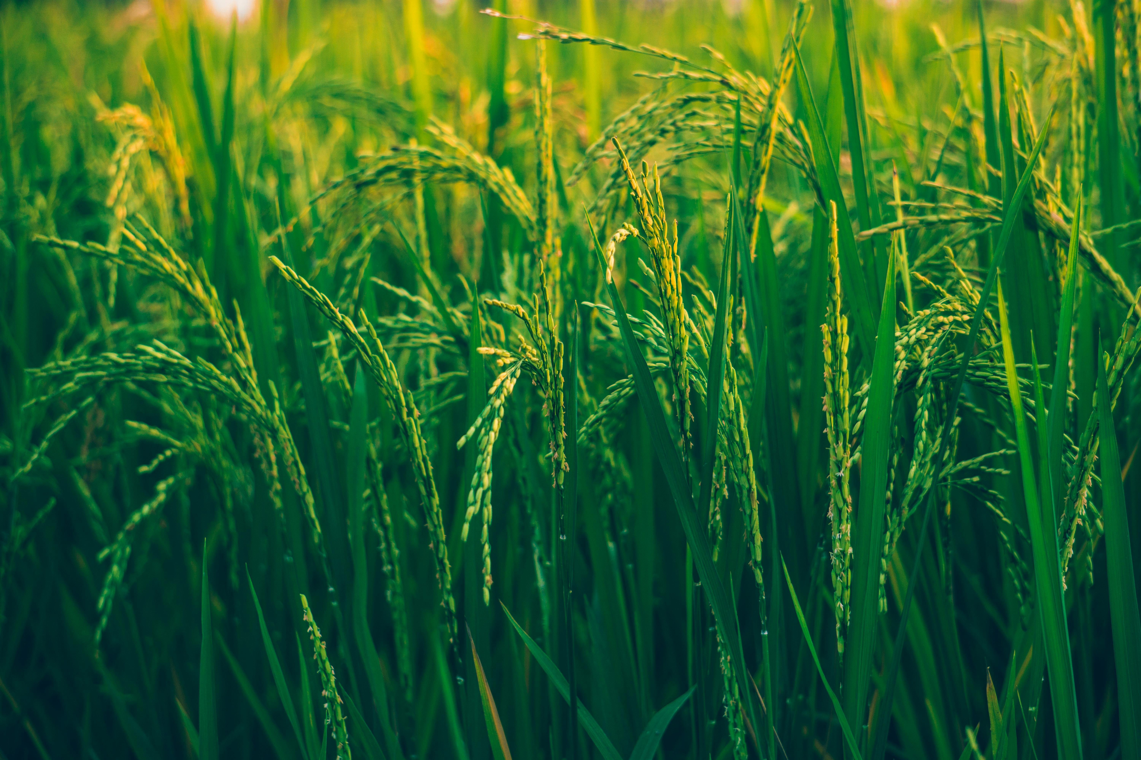
Cons of nature
Gives different fertile
Creat natural land
Source of water
Source of food

Slide 7
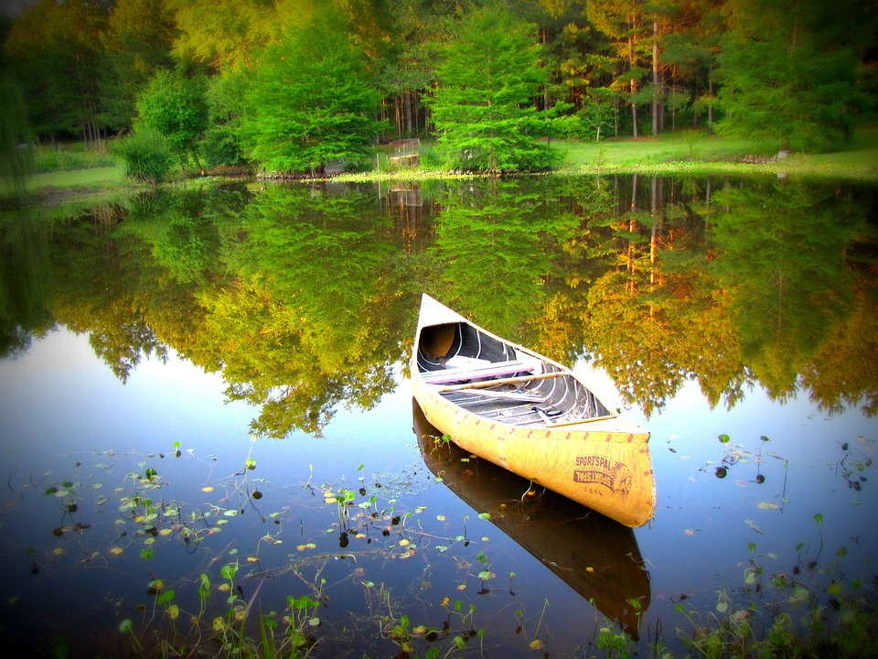
Causes 0f attraction of Naturwe
Natural disply
Source of life
Gives entertainment
Creat natural field

Slide 8
conclution
Reduces anger, fear, and stress
Increases pleasant feelings
Contributes to physical wellbeing by reducing blood pressure, heart rate, muscle tension, and the production of stress hormones
Activates the part of the brain associated with emotions, empathy, and self-awareness
H

Slide 9


